Slide 1
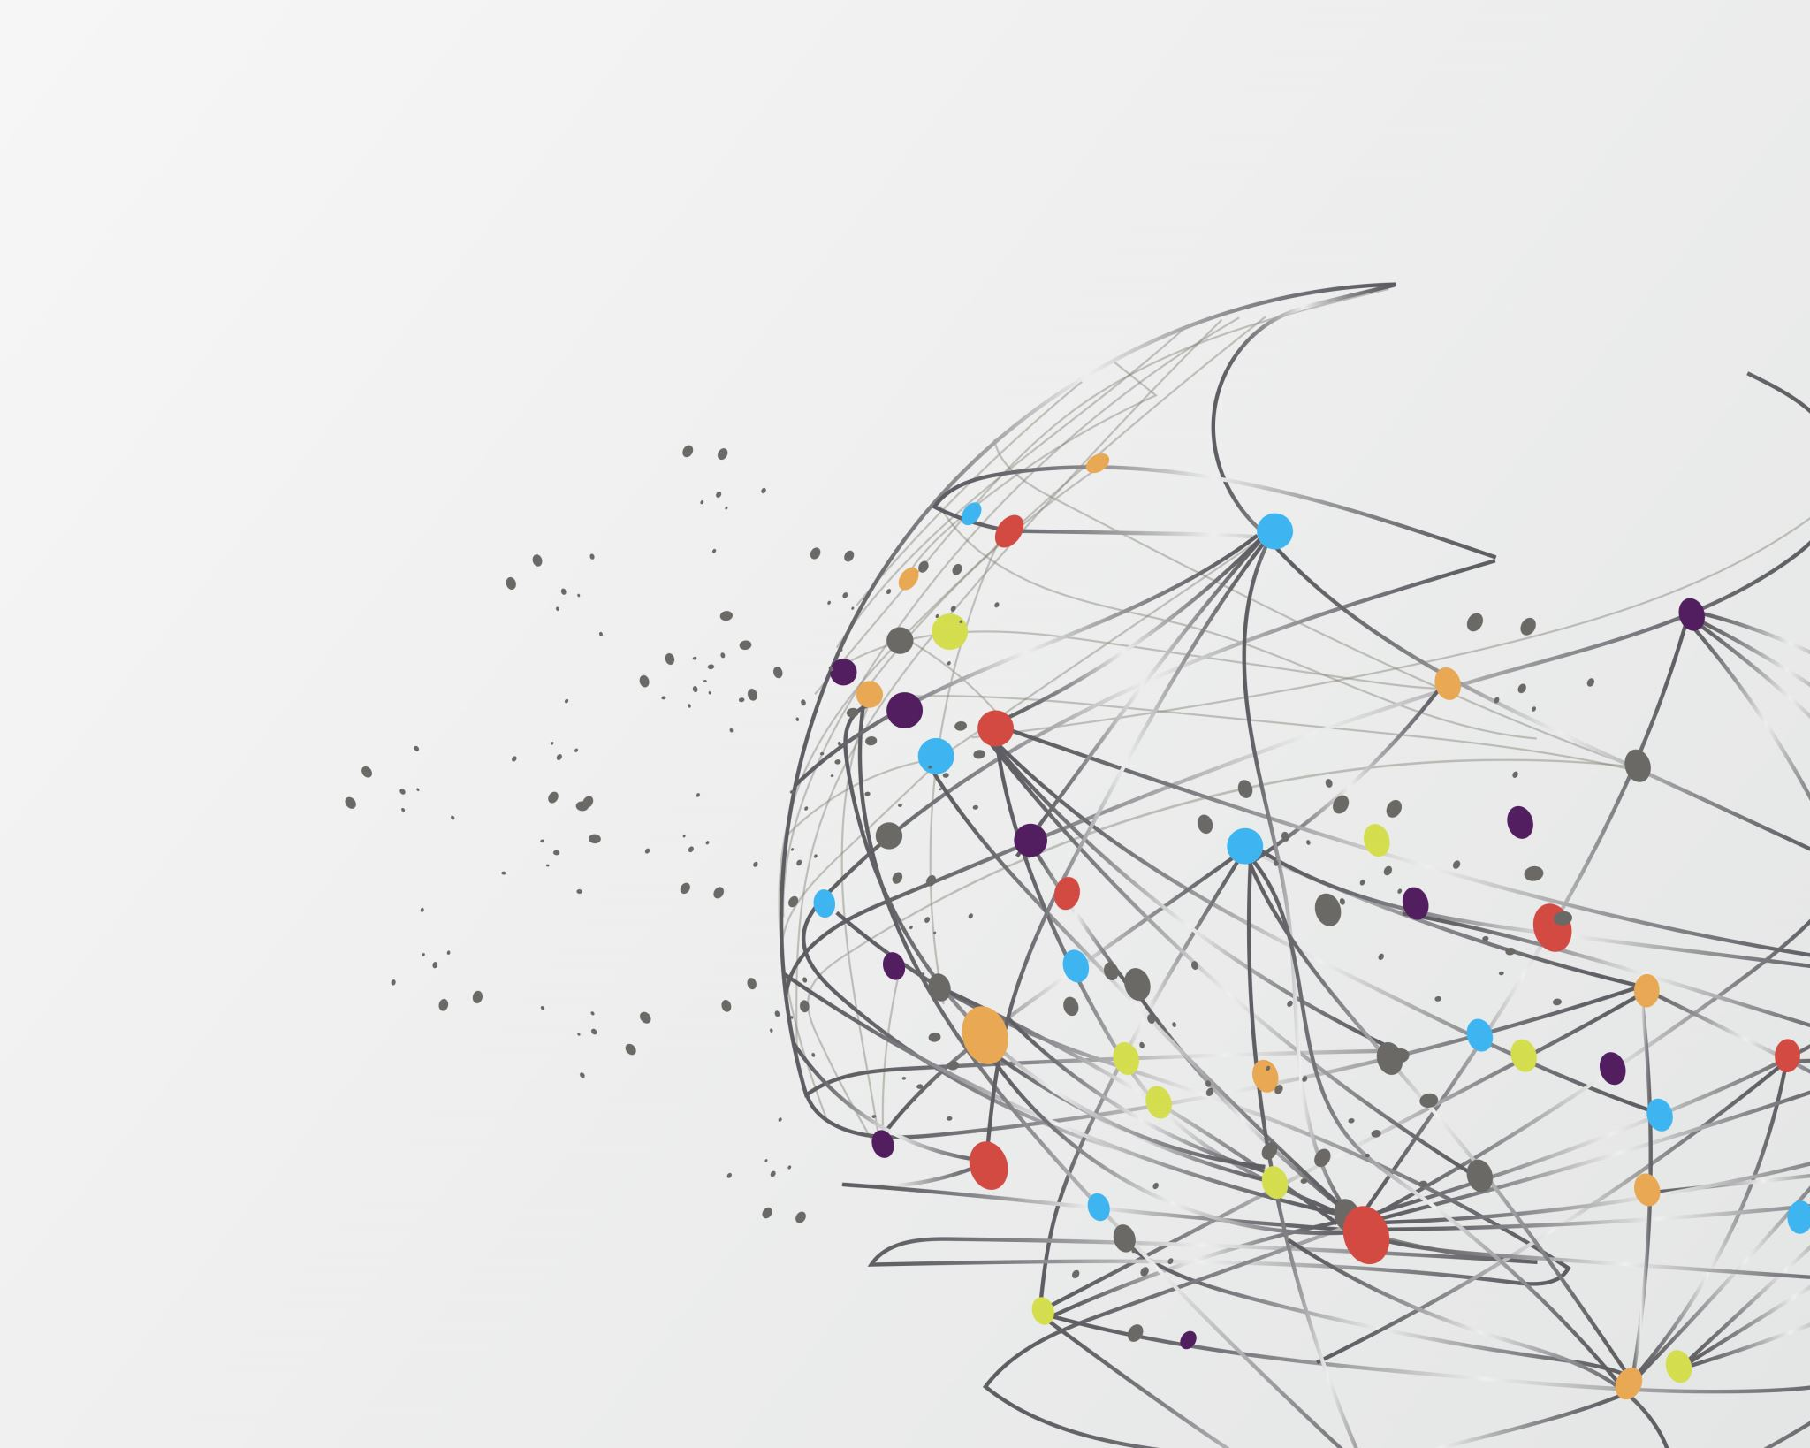
Customer Segmentation and Clustering
Group 7 Section 003
Aashutosh Sehgal – 0780170
Dattu Reddy Pedholla – 0782042
Devashish Patel – 0781214
Rachna Rachna – 0782821
Rohit Rohit - 0773987

Slide 2
Overview Of Problem
The objective of this project is to perform segmentation of the customers and use clustering to determine the optimum number of clusters required. It focuses on the sales data of 541,909 customers world-wide. We analyzed the data to divide the customers into groups or clusters based on one or more common characteristics.
At the same time, we identified the loyal , most profitable customers along with the ones that churned away.

Slide 3
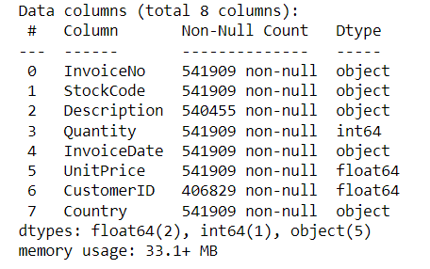
Review of Data Source
The dataset contains 541909 rows and 8 columns. Each row represents a customer, and each column contains customer’s features described on the column metadata. Description for each feature is given below:
InvoiceNo – Unique number for each invoice.
StockCode – Code number for each stock.
Description – Description of items in each invoice.
Quantity -- Quantity for each item.
InvoiceData – Date for which invoice was generated.
UnitPrice -- Unit Price for each item.
CustomerID - Customer ID is unique for each individual customers.
Country – Country for which each invoice is generated.

Slide 4

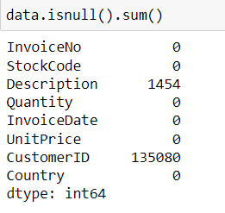
After a preliminary gander at the data, we determined that there are various fields which contain null values and duplicate values.
After performing data cleaning, we performed Exploratory data analysis to understand the data clearly.

Slide 5
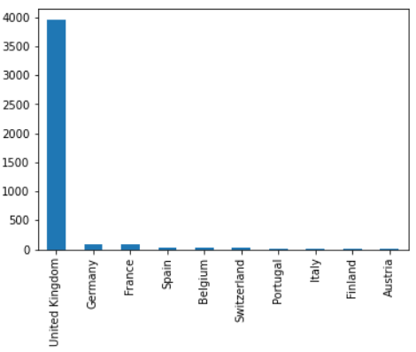
Descriptive Insights
After performing the data cleaning mentioned previously, we have a filtered dataset which does not contain duplicates in the Country and CustomerID columns.
The bar chart on the right shows us the distribution of the filtered dataset of the customers from the top 10 countries by total count.
Clearly, United Kingdom is the country which has the maximum customers followed by other European countries like Germany, France, Spain, etc. as shown.
Once we were done with data cleaning and generating summary statistics shown previously, we performed RFM (Recency Frequency Monetary) analysis and Clustering using Machine Learning algorithms like K-means and Hierarchical Clustering.

Slide 6
Results
For the RFM analysis, we normalized the RFM values from 1 to 5 based on the quintiles (divisions) of the data.
Based on this methodology, we segmented the customers into 6 segments namely:
At risk: Customers that have a low recency (1-2) score and a frequency score of 1 to 4.
Needs attention: Customers that have a recency score of 3 and a low frequency score to 1 to 3.
New: Customers that have a high recency (4-5) score while a low frequency score of 1.
Can’t lose: Customers that have a low recency (1-2) score while a high frequency score of 5.
Loyal: Customers that have a medium recency (3-4) score while a high frequency score of 4 to 5.
Champions: Customers that have a high recency (4-5) score as well as a frequency score of 2 to 5.

Slide 7
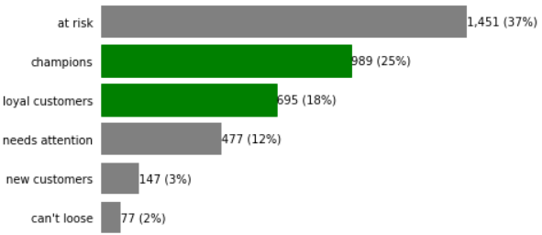
Interpretation
RFM Analysis
We generated the plot on the right, where we can see that based on RFM score:
Out of the total customers:
45% customers cumulatively belong to the loyal, champions and can’t lose categories.
27% are on the verge of moving away.
12% need attention to convert them to the 45% category.

Slide 8
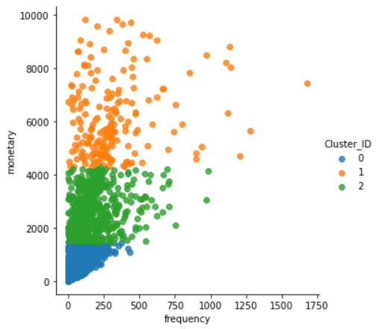
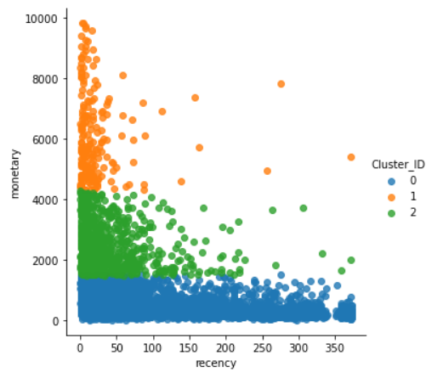
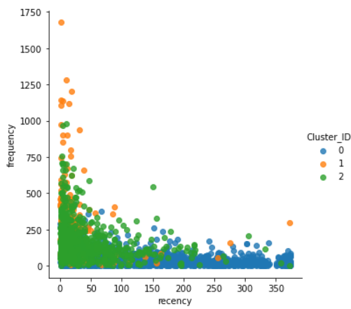
Clustering
Our prime objective is to divide our customers into segments.
We have used clustering, in which we have visualized the number of clusters graphically. From the analysis, we can see that there are 3 different segments of customers as shown below.
We can see that the clusters are visually defined and separated clearly for the graphs of monetary vs frequency as well as monetary vs recency. We can see that frequency vs recency has very mixed clusters.
Also, we can see that monetary vs frequency has a positive and linear relationship, while monetary vs recency and frequency vs recency have negative and non-linear relationships.

Slide 9
Future Recommendations/Proposal
Firstly, we need to focus on the customers that are on the verge of moving away (27%) as well as the customers that need attention (12%). With the help of these segmentation techniques, we can use targeted marketing schemes for these segments. For example, one could offer retainment (loyalty) benefits, discounts, targeted ads etc.
Based on the 2 clustering algorithms and optimum cluster algorithms like Elbow method, Dendrogram plot, we divided the customers into 2 and 3 clusters respectively.
For the customers divided into 2 clusters, it is very difficult to extract any business value from these clusters as they only give a very brief overview of the customers inadvertently making it impossible to apply any effective marketing strategies on them.
On the other hand, when we divided the customers into 3 clusters, it is possible to have a better understanding of the segments and consequently determine better marketing strategies. Hence, it is better to use 3 clusters because our marketing strategies will be more effective when we have a clear customer split.

Slide 10
THANK YOU

